Slide 1
May 28, 2026
Vendor Advisory Committee (VAC)
Systems Update
Presentation
Gloria Wong
Executive director

Slide 2
AGENDA
LANTERMAN 60th Anniversary
I.
        https://lanterman.org/60for60/
        Senate Concurrent Resolution 174
        Resolved by the Senate of the State of California, the Assembly thereof concurring, That the Legislature recognizes the year of 2026 as the 60th anniversary of California’s two pilot regional centers, Frank D. Lanterman and Golden Gate; and it be further
          Resolved, That the Legislature celebrates its historic 1966 enactment of AB 691 of the 1966 Regular Session of the Legislature, and reaffirms its commitment to ensuring a sustainable future for California’s community service system; and be it further

Slide 3
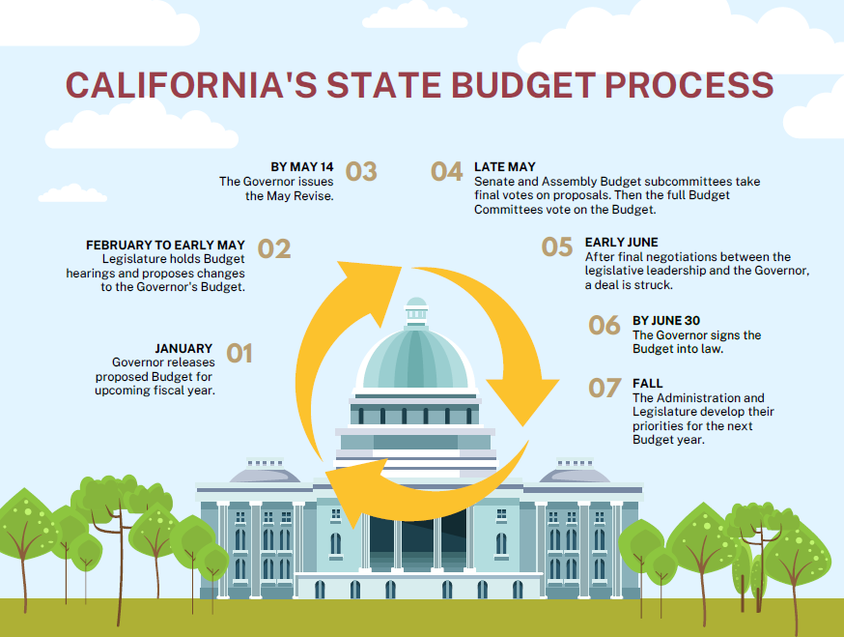

Slide 4
II.
  A. California’s State Budget Process
              Governor’s January Preliminary Budget
              Governor’s May Revision
              Legislature Budget Hearings
                Senate Budget Subcommittee #3 Health & Human Services
                Chair: Senator Caroline Menjivar
                Assembly Committee Budget Subcommittee #2 Human Services
                Chair: Assembly Member Dr. Corey A. Jackson
2026-’27 Proposed Budget Highlights

Slide 5
  B. Budget Overview: No Reductions
        1) Allocation
              $21.6 Billion
              $2.8 Billion Increase from 25’-’26
              $8 Billion Federal Medicaid Funds
              39,700 Projected increase in individuals served
              527,000 Individuals Served Statewide
        2) Proposals
              Federal Funding
                Increase Federal Reimbursement by $50 million
                Quality and Accuracy of Data Improvement
              Implementation of the Federal Home & community Based Service (HCBS) Access Rule
                Implementation of the new federally mandated grievance process

Slide 6
  C. Equitable & Consistent Needs Assessment
            Standardized the intake process for 21 Regional Centers
          D. Development of New Rate Models for centered-based early intervention
          services & the family teaching model
          E. Allowance for individuals receiving supported employment services to receive
          additional individualized Tailored Day Services
          F. Porterville Developmental Center
              Rehabilitation Project: Firesprinklers
          G. Proposed Changes to Laws
              Rate reform cleanup
              Merging the Community Placement Program (CPP) and Community Resource Development Plan (CRDP)
              Establishing time limits for Canyon Springs & Porterville Developmental Center residents

Slide 7
III.
        Purchase of Services (POS): 90.8% ($16.5B)
        Operations: 9.1% ($1.7B)
        Total $18.2B
IV. Questions / Comments
Thank You
Retrospect: 25-26 FY Enacted Budget

